Slide 1






Slide 2
AILA Citizenship Day
AILA's 20th annual Citizenship Day will take place on or around Saturday, September 20, 2025
Citizenship Day is a nationwide event hosted by AILA chapters across the country along with local grassroots partners. Each year, Citizenship Day helps thousands of eligible legal permanent resident prepare and apply for U.S. naturalization.
AILA National provides training series to prepare Citizenship Day Coordinators and volunteers to feel confident for their community event.

Slide 3


American Immigration
Lawyers Association
Paul Rampersaud
Grassroots Advocacy Associate
prampersaud@aila.org
CUNY Citizenship Now!
Shawn Rahman, Esq.
Managing Attorney, Training & Capacity Building
shawn.rahman@cuny.edu

Slide 4
Webinar Outline
Naturalization Fee Waivers Using Public Benefits
  Types of Public Benefits
  Eligibility
  How to complete I-912
Naturalization Fee Waivers for Income At or Below 150% of the Federal Poverty Guidelines & for Temporary Financial Hardship
  Eligibility
  How to complete I-912
Reduced Naturalization Fee with Income Between 150% and 400% of Federal Poverty Guidelines
  Eligibility
  Now part of N-400; Previous I-942 Eliminated

Slide 5
Eligibility Requirements for Fee WaiverS

Slide 6
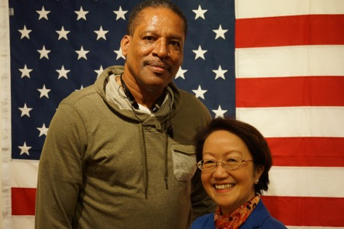
USCIS Fee-Waiver for Naturalization
1) Fee for N-400 Application is now $760 (includes Biometrics Fee)
2) For those with household income between 150 – 400 % of poverty guidelines eligible for Reduced Fee $380
3) Full Fee Waiver still available

Slide 7
Completing Form I-912

Slide 8
General Recommendations
Fillable PDF recommended (check USCIS website for latest version)
  2013 version still accepted and much shorter (easier)
USCIS still not accepting fee-waivers via electronic filing
For applications completed by hand:
  ALWAYS use a BLACK ballpoint pen
  PRINT legibly. Do not use cursive script
Be sure to complete all relevant portions of the form, and have applicant(s) sign, date and print his or her name
On the I-912 Form, blank spaces for items that do not apply are OK
Write dates in the order month/day/year using eight digits (mm/dd/yyyy)
All official agency documents submitted to USCIS must be in English
  Applicant should be provided a handout on how to obtain proper documentation if missing

Slide 9

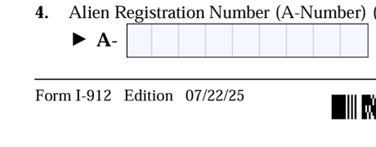
Completing the I-912
Current edition: 07/22/25 Edition; Expires 03/31/2027; 8 Pages
TOP RIGHT; PAGE 1
BOTTOM LEFT; PAGE 1

Slide 10
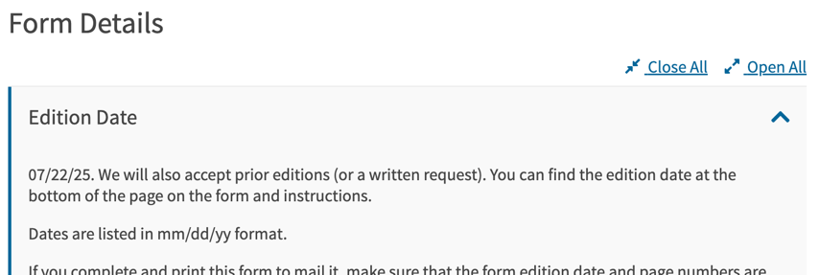
Completing the I-912
Prior Editions Still Accepted
https://www.uscis.gov/i-912
Current edition: 07/22/25 Edition; Expires 03/31/2027; 8 Pages
05/10/13 Edition; Expired 05/31/2015; Only 5 Pages

Slide 11
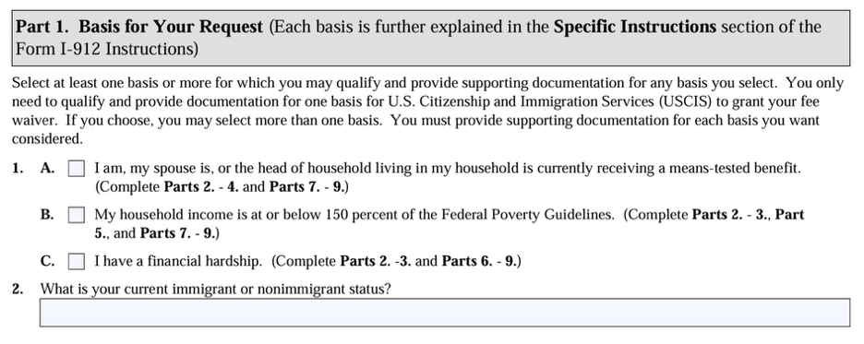
Part 1: Basis for Your Request
Select at least 1 option under which Applicant may qualify:
Complete the corresponding sections as instructed in application

Slide 12
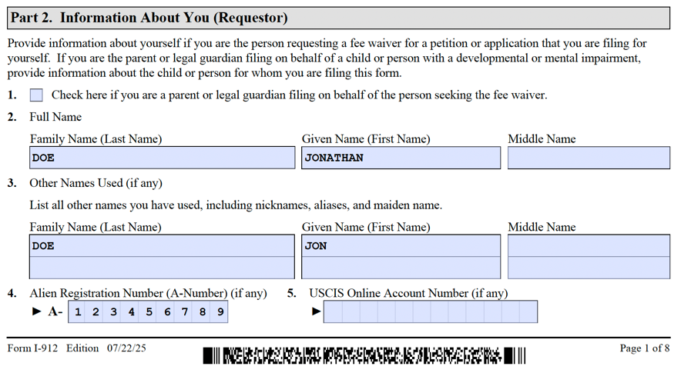
Part 2: Information About You (Requestor)
Part 2 – Q’s 1-8 Information About You: MUST MATCH N-400 or Application

Slide 13
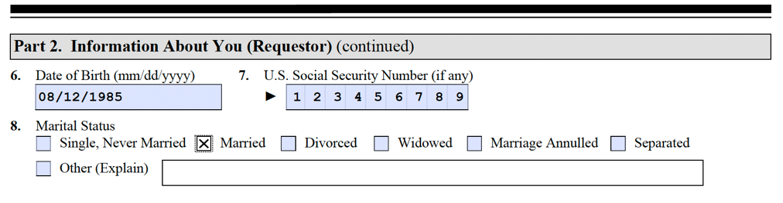
Part 2: Information About You (Requestor)
Part 2 – Q’s 1-8 Information About You: MUST MATCH N-400 or Application
”Separated” means legally separated (in legal proceedings to dissolve marriage)

Slide 14
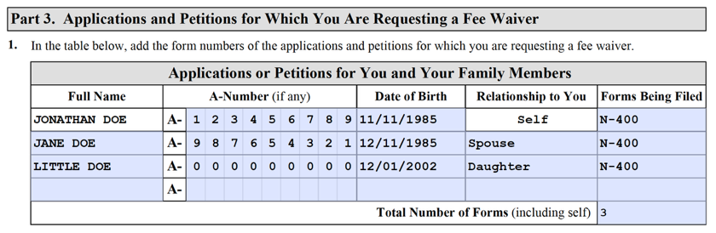
Part 3: Applications and Petitions for Which You Are Requesting a Fee Waiver
Can be used for multiple applicants and forms. Make sure to include each applicant’s:
Full Name
A-Number
DOB
Relationship to primary applicant
Form being filed
Total Number of Forms being filed

Slide 15
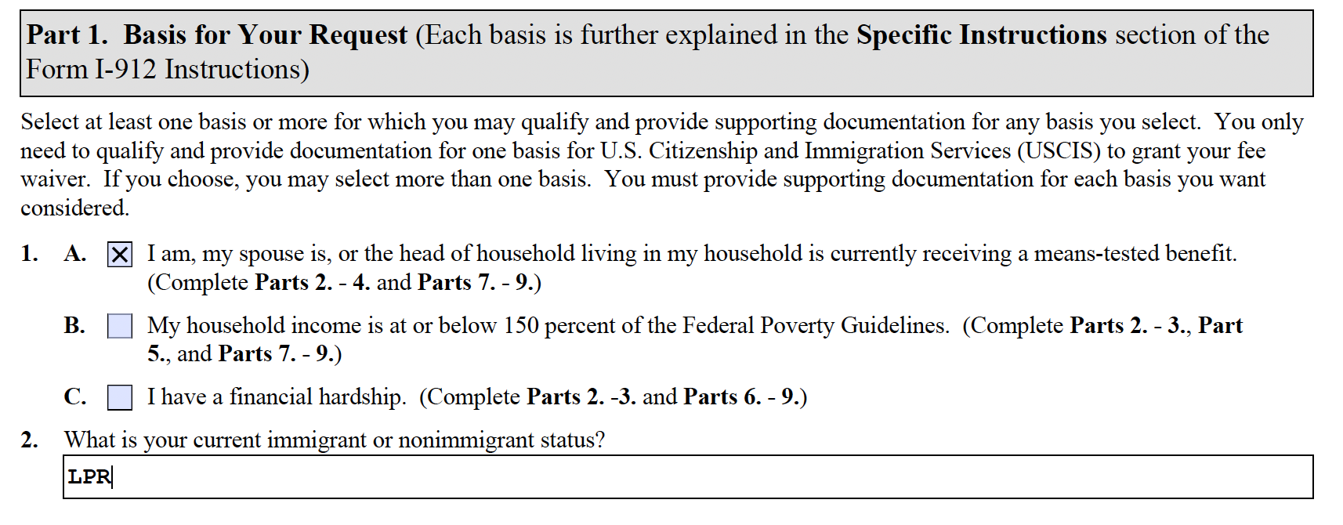
Means-Tested Public Benefits

Slide 16

Means-Tested Public Benefits
A “means-tested benefit” is a public benefit where the eligibility for benefit and amount received are determined by income and resources
Determination made by agency in charge of administering benefit
As long as sufficient proof is submitted, no further information is required by USCIS to show eligibility for fee waiver

Slide 17
Examples of “Means-Tested Benefits”
Benefit | Agency (Varies by State/Locality)
Public Assistance (PA) Cash Assistance (CA) FEPS: Eviction Prevention HEAP: Heating Assistance Food Stamps (Supplemental Nutrition Assistance Program [SNAP]) Medicaid (MA) Essential Plans (All in NY; can vary by state) | NYC Human Resources Administration (HRA) NYC HRA or NY State of Health NY State of Health https://www.healthcare.gov/marketplace-in-your-state/
Supplemental Security Income (SSI ) | Social Security Administration (SSA)
Public Housing Section 8 housing | NYC Dept. of Housing Preservation & Development NYCHA NYS Housing and Community Renewal (NYS DHCR)

Slide 18

NOT “Means-Tested Benefits”
Social Security Disability Insurance (SSDI)
Social Security
Worker’s Compensation
State Disability & Injury Benefit Programs
Unemployment Insurance
Student Loans
Scholarships/Fellowships
Pensions
Spousal Support
Child Support

Slide 19

Practice Point: Supporting Documentation
Means-Tested Benefits
Supporting Documents: Means Tested Benefits
Look for these four things on the award letters:
Participant’s Name
Name of benefit awarded
Name of agency administering the benefit
Amount of benefit awarded (SSI or SNAP)
Most recent date the participant was approved to receive the benefit
    - MUST be within the last year

Slide 20
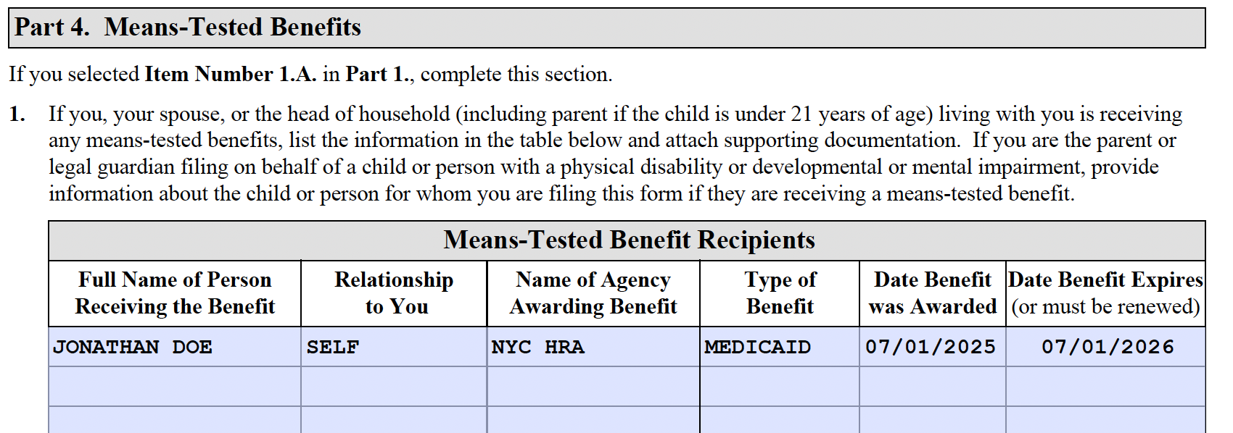
Part 4: Means-Tested Benefits
Fill out if you selected Item Number 1 in Part 1 Complete Table and include:
Name of the person receiving the benefit
(in most cases the Applicant but could be
a relevant family member)
Relationship to Recipient
Name of the Agency
Benefit Awarded
Date Benefit was Awarded
Date Benefit Expires (or must be renewed)***

Slide 21
Sample Supporting Documents:
Means Tested Benefits

Slide 22
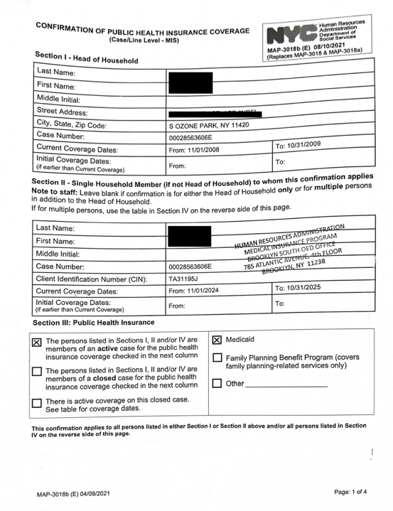
Sample Medicaid Letter
NYC HRA

Slide 23
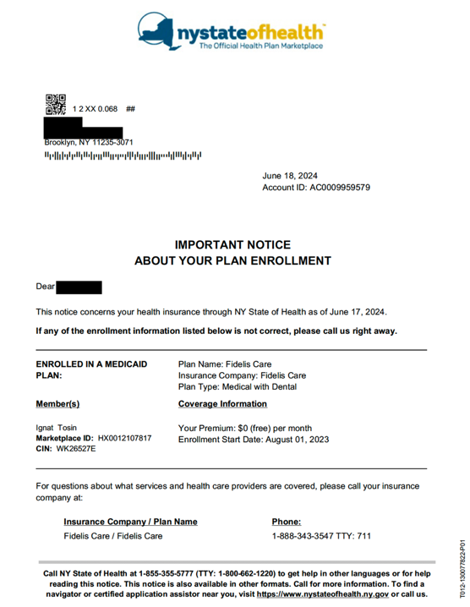
Sample Medicaid Letter
NY State of Health
(NYSOH)

Slide 24
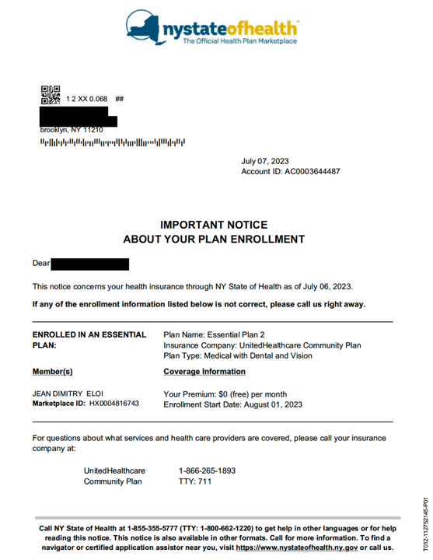
Sample Essential Plan Letter
NY State of Health
(NYSOH)

Slide 25
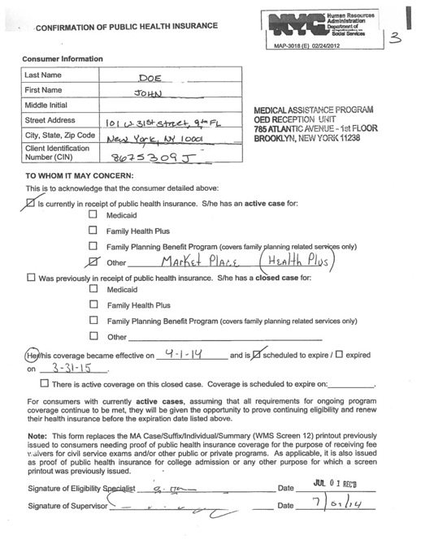
Sample Rejected Medicaid Letter
“Medicaid” Not Checked

Slide 26
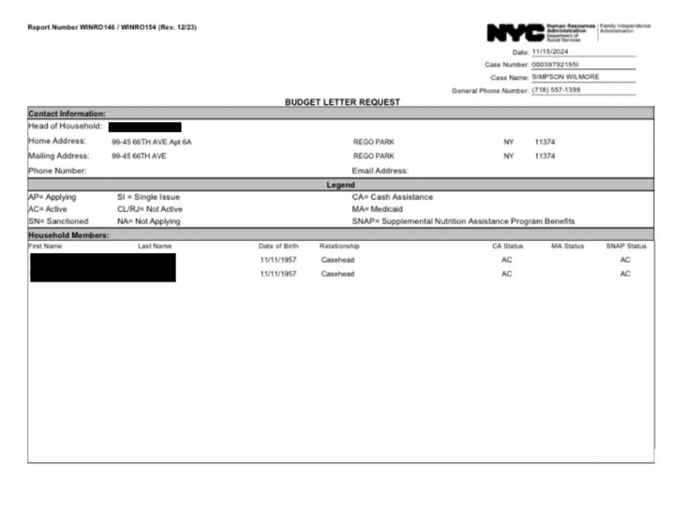
Sample SNAP Budget Letter
NYC HRA

Slide 27
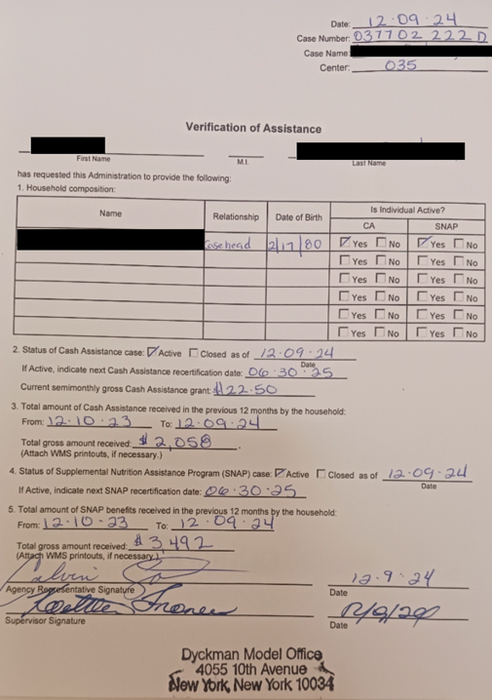
Sample Cash Assistance
NYC HRA

Slide 28
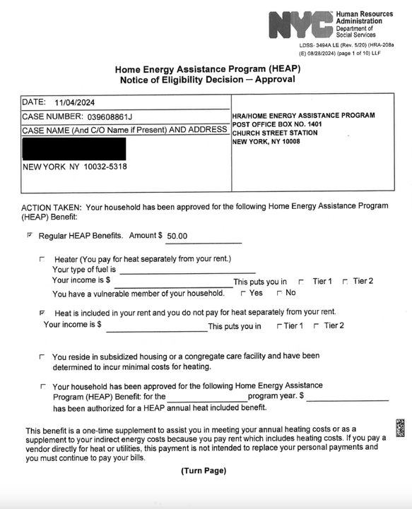
Sample Home Energy Assistance Program (HEAP)
NYC HRA

Slide 29
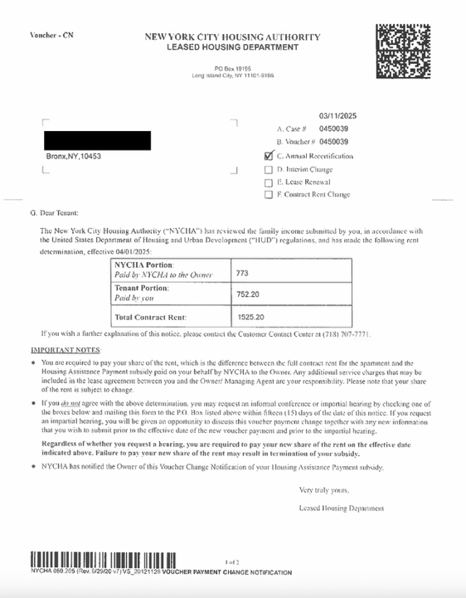
Sample Section 8 Housing Voucher
NYCHA

Slide 30
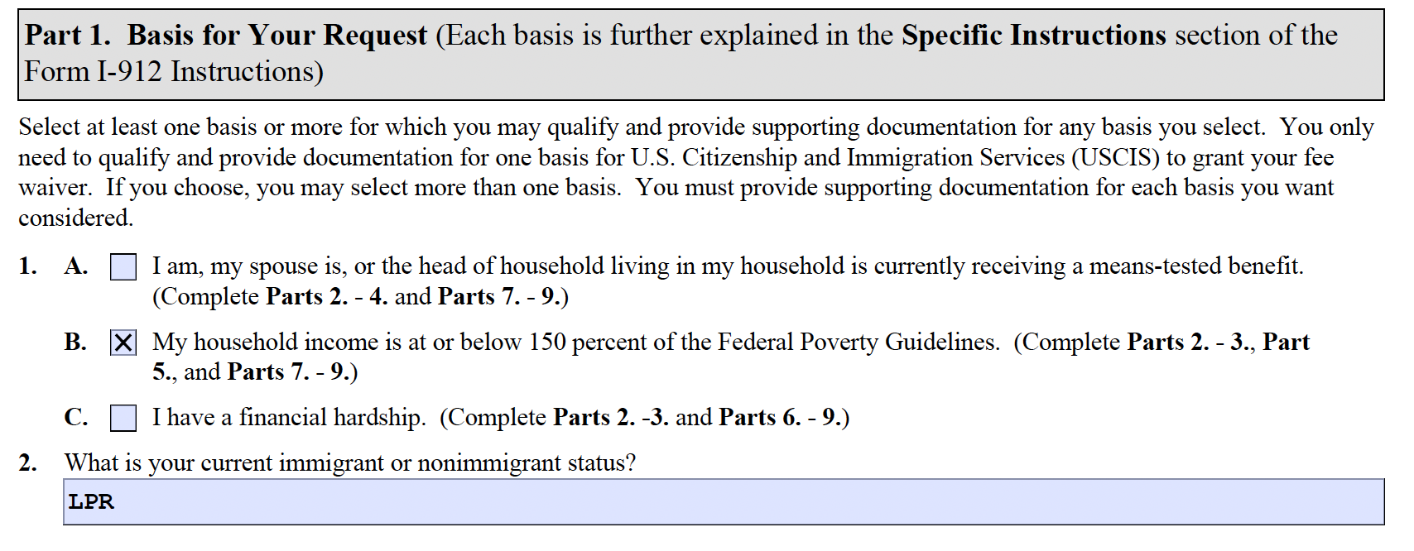
Income at or below 150% of Poverty Guidelines

Slide 31
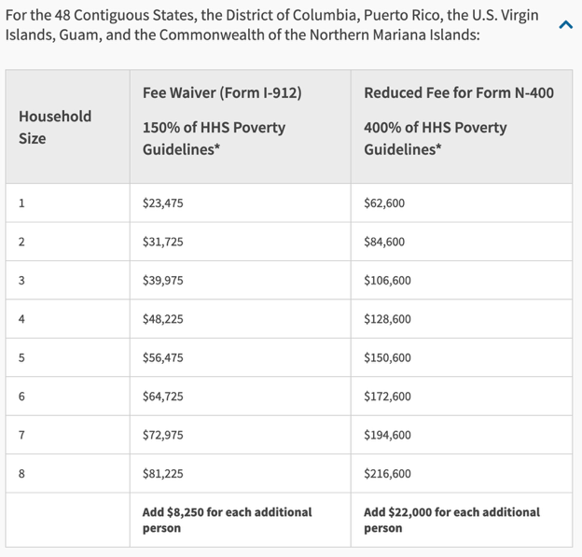
Section 5: Household Income
https://www.uscis.gov/i-912p
Compare the income from Applicant’s most recent tax return using ADJUSTED GROSS income (amount of money Applicant made before taxes were taken out of paycheck) to the Federal Poverty Guidelines (see
Form I-912P)
In order to qualify for Fee Waiver on this basis, income must be BELOW corresponding figure for the household size on Form I-912P
Must submit FEDERAL Tax Transcript as supporting documentation

Slide 32
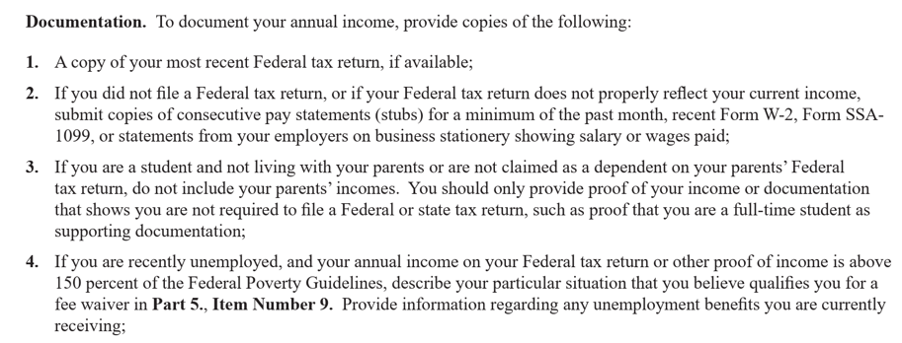
Transcripts, Not 1040s
  Form 1040, the Federal Tax Return may no longer be accepted to document income, despite the instructions.
  If a Tax Return was filed, then a Tax Return Transcript should accompany the I-912 in lieu of the Tax Return Copy.

Slide 33
IRS Tax Return Transcripts
  The IRS offers 5 transcripts:
    Tax Return Transcript: shows most line items including the Adjusted Gross Income (AGI), all dependents, and includes all schedules. THIS IS THE ONE TO SUBMIT WITH THE I-912.
    Tax Account Transcript: shows basic data of filing
    Record of Account Transcript: Combines both above
    Wage & Income Transcript
    Verification of Non-Filing Letter
  https://www.irs.gov/individuals/tax-return-transcript-types-and-ways-to-order-them

Slide 34
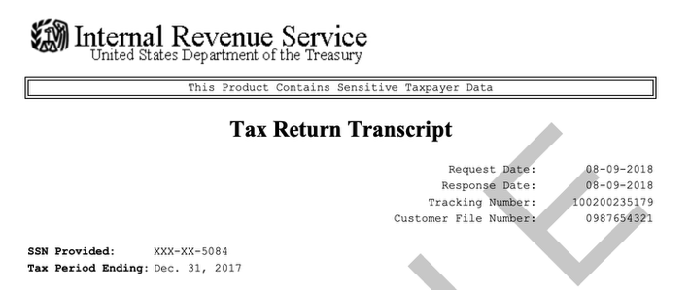
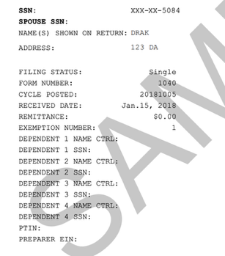
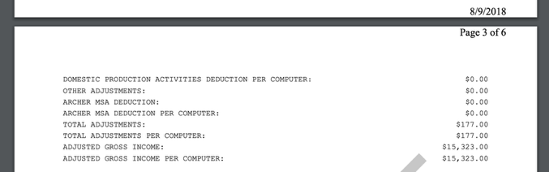
Tax Return Transcript
ADJUSTED GROSS INCOME

Slide 35
Helping Applicants Obtain
their Tax Return Transcript
Order Online Immediate Delivery: requires registration and precise data entry, which can be quirky. But immediate delivery.
Order Online for Mail Delivery: requires SS, DOB, and exact mailing address from latest return. Can be quirky with the address. Takes 5-10 business days to deliver.
Order by Mail using Form 4506-T; probably easiest for most clients, but requires a mailing (postage). Also takes 5-10 business days.
Order by Phone by Calling 800-908-9946; also takes 5-10 business days

Slide 36
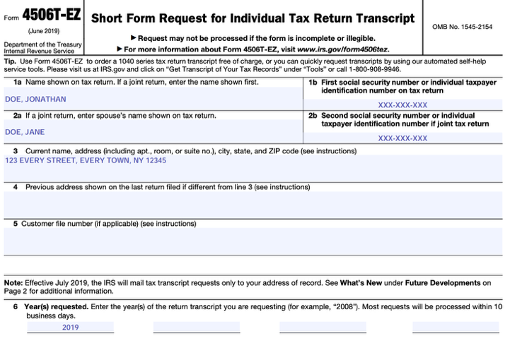
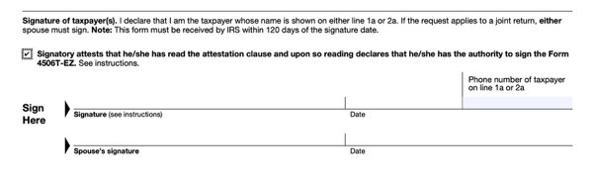
IRS Form 4506T-EZ

Slide 37
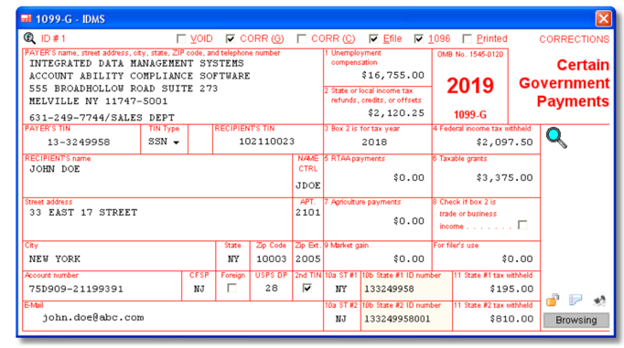
Exceptions to Transcripts
Only those who did not file a tax return for most recent period are exempt from submitting Tax Returns/Transcripts.
  Unemployed & received unemployment benefits: Submit form 1099-G; INCLUDE ALL PAYMENTS

Slide 38
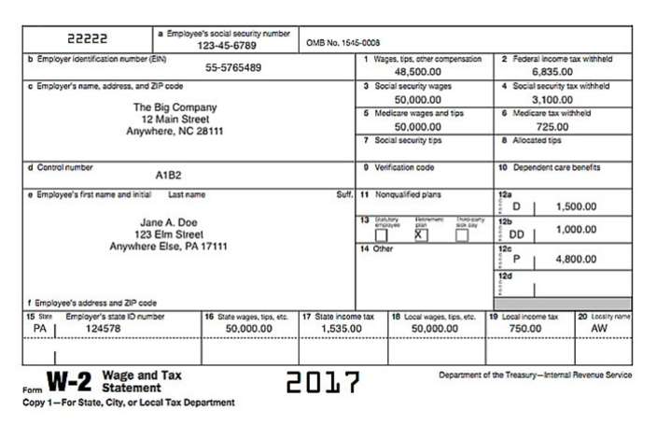
Exceptions to Transcripts
  If working or employed during last period: Submit recent W2 or Social Security Statement earnings record

Slide 39
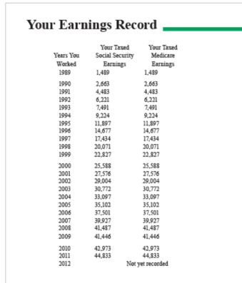
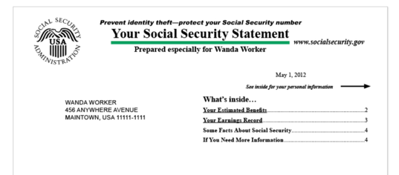
Exceptions to Transcripts
  If working or employed during last period: Submit recent W2 or Social Security Statement earnings record

Slide 40
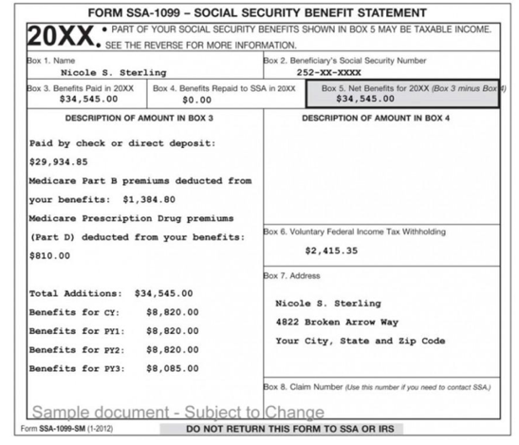
Exceptions to Transcripts
Social Security benefits only: Submit form SSA-1099

Slide 41
Some Other Exceptions to Transcripts
  Unemployed & did not receive unemployment benefits: Submit letter of termination from employer
  If no income or can’t document income, complete Part 3 Item 12 (change of circumstances) PLUS documentation from IRS confirming no transcripts or W2s
  If homeless:
    Submit documentation from IRS of no transcripts or W2s; or
    Affidavit from religious institution or non-profit community organization of support received

Slide 42
Documentation Red Flags
On income & amounts reported, treat tax transcripts/returns as presumptively accurate
  i.e. Assume correctly reported income
  Refer applicant to accountant or tax preparer instead of giving tax advice
However, we should screen for potential red flag issues:
  Head of Household filings; esp. if married
  Adult household members not listed on transcripts
  Adult children over 21, unmarried, living with parents, and listed as dependents on parents’ return
  Taxes not filed, and no apparent valid reason not to file
  Students not living at home but still tied to household
  People listed as dependents who do not live with Applicant

Slide 43
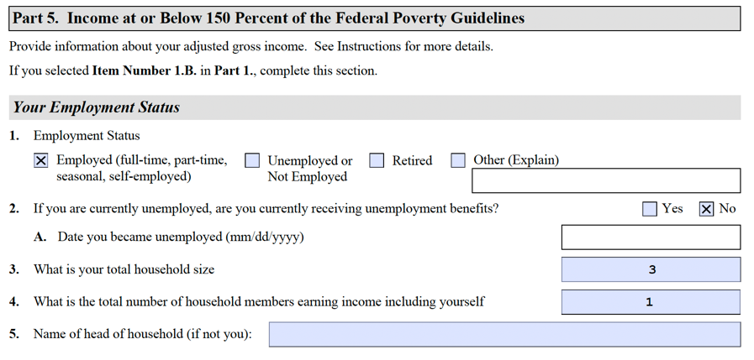
Part 5: Income at or Below 150 Percent of the Federal Poverty Guidelines
Current employment status on date signing the I-912
Approximate Date is OK
Practice Tip: Compare HH Size Here to Tax Transcript/Return

Slide 44
Practice Point: Determining Household Size
The number of members in a household should be identifiable on Applicant’s most recent Federal Income Taxes (Transcripts & Returns)
If Applicant’s most recent Federal Income Taxes are not available, the following household members should be included:
  Spouse
    If Applicant is married and does NOT live with spouse, Applicant DOES NOT need to list him/her as a household member, but must include any financial support the spouse provides (if any)
    If spouses do not live together and no support is provided to household, write a brief explain about this in Section 5, Item 9.
    Unmarried Children or Legal Wards (i.e. foster children) under age 21 and living with Applicant
  Unmarried Children or Legal Wards 21-24 years old, who are full-time students AND living with Applicant
  Unmarried Children or Legal Wards for whom Applicant is legal guardian because they are physically and/or mentally disabled to the extent they cannot adequately care for themselves and cannot establish, maintain or re-establish their own household
  Parents
  Anyone who has lived with the Applicant for the last 6 months of the tax year, for whom the Applicant provides > 50% of their living expenses.

Slide 45
USCIS Income Guidelines
Check Household Size & USCIS Income Guidelines Chart to confirm eligibility:
  < 150%; I-912 (Full Fee Waiver); Form I-912P
  150% to 400%; I-942 (Partial Fee Waiver for
  N-400 Only);
  On N-400

Slide 46
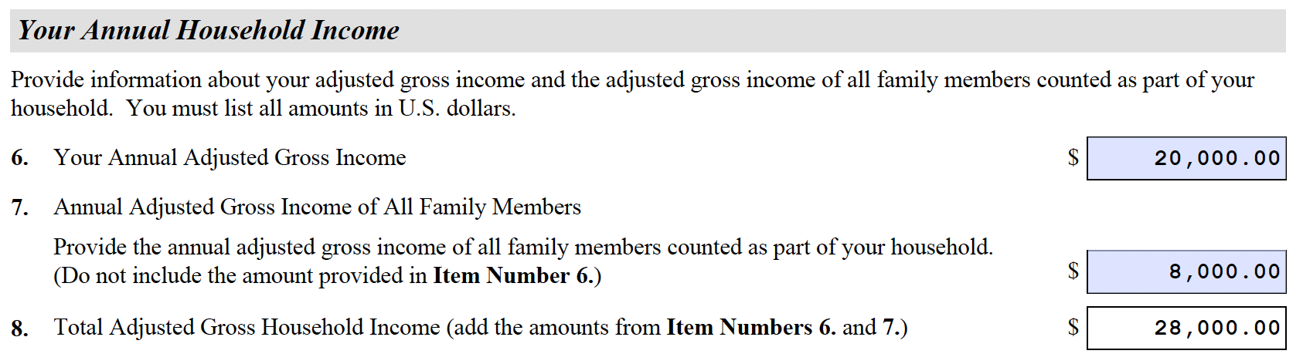
Part 5: Income at or Below 150 Percent of the Federal Poverty Guidelines
Household Income; Qs 5-7

Slide 47
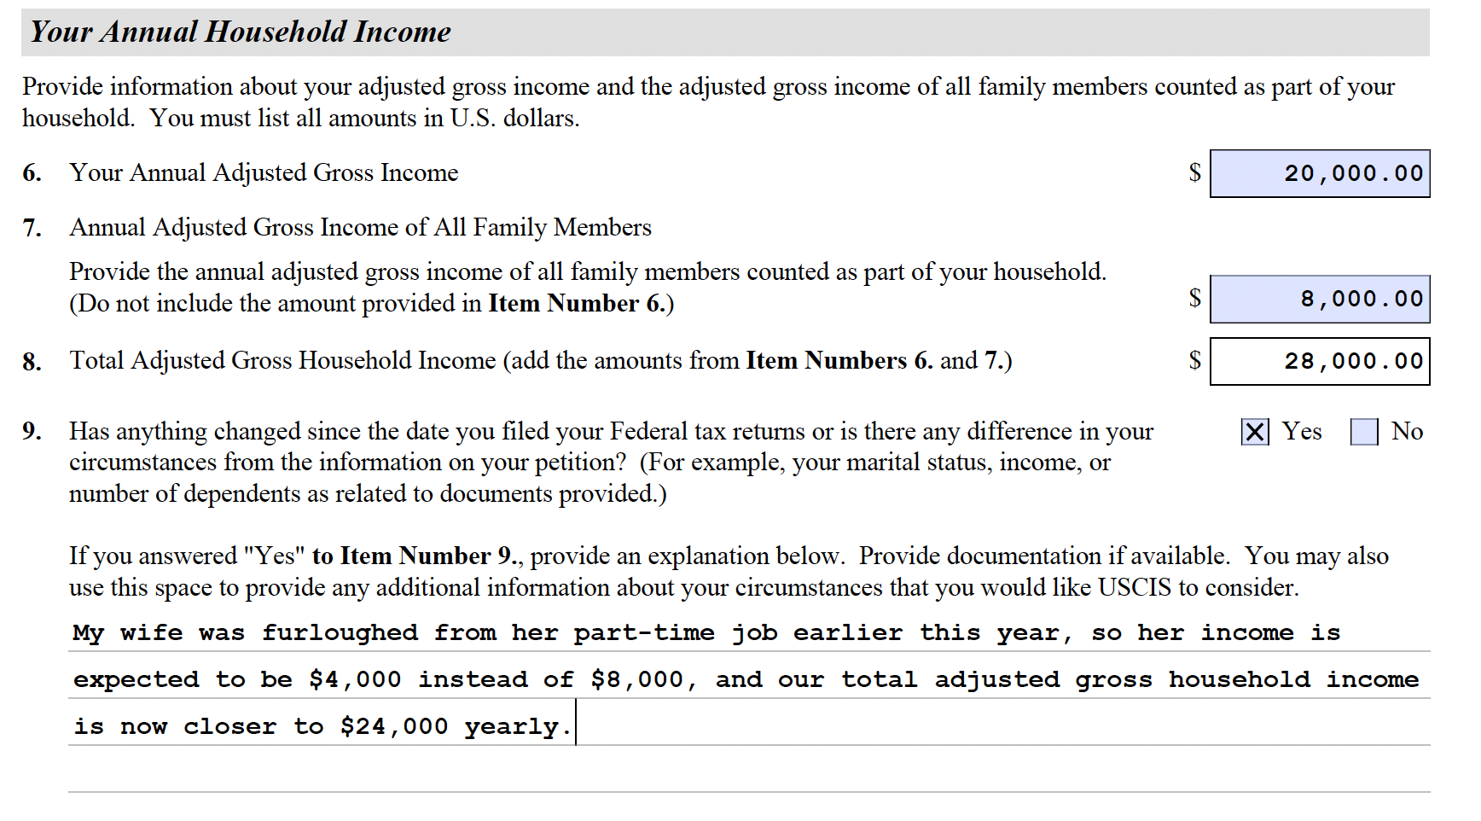
Part 5: Income at or Below 150 Percent of the Federal Poverty Guidelines
Household Income; Qs 8-9
Insert total of # 6-7; auto fill if using current PDF
Practice Tip: Q9 - Explain any change of circumstances, if any, that may favor the petition for fee-waiver; esp. if Q8 answer shows too much income, but now reduced enough to qualify (at time of application)

Slide 48

Practice Point: Household Income
Below 150% RED Flags
Head of Household: Allows for certain tax credits not available under Married or Single
  Requirements:
    Considered Unmarried
    Paid > ½ Cost of keeping your Household for entire year
    Qualifying person LIVED WITH you for > 6 months (except dependent parents)
  Qualifying Person
    Child, Parent, or Relative: Must meet specific requirements for each
Dependents
  If not filing under Head of Household status, taxes may still be “bad” if inaccurately claiming child or relative for exemption purposes
Refer Applicant to free tax prep providers if you see these issues!

Slide 49
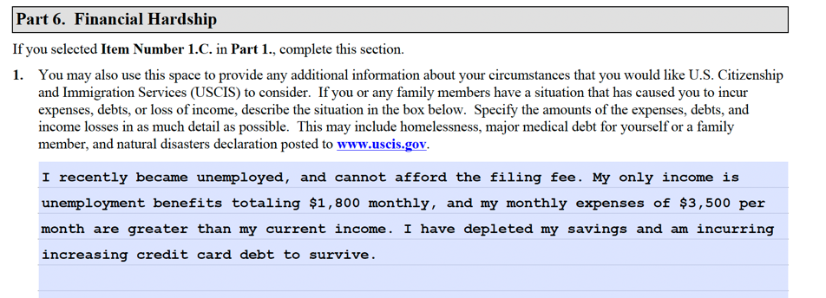
Part 6: Financial Hardship
Time and resource intense
Requires more documentation
More difficult for USCIS to approve (case-by-case basis)
Practice Tip: Q1 – Must be an actual “situation” that is “extraordinary” (i.e. not ordinary, and not poor financial management). Avoid descriptions that cannot be documented; will almost certainly be rejected or issued an RFE if documentation is not included.

Slide 50
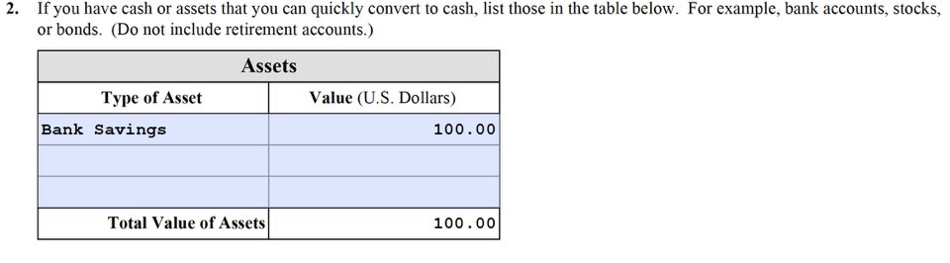
Part 6: Financial Hardship
Part 6, Question 2 – Cash or Cash Equivalent Assets
Practice Tip: Q2 – Probably not going to be approved if cash or equivalent assets significantly exceed the application processing fee. Check reference in USCIS Field Manual: if cash assets can be liquidated without incurring further financial hardship, will likely be denied.
https://www.uscis.gov/sites/default/files/document/policy-manual-afm/afm10-external.pdf

Slide 51
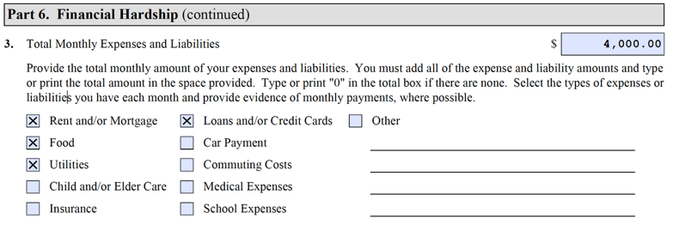
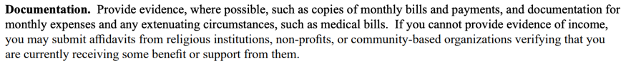
Part 6: Financial Hardship
Part 6, Question 3 – Expenses / Liabilities
From USCIS I-912 Instructions:

Slide 52
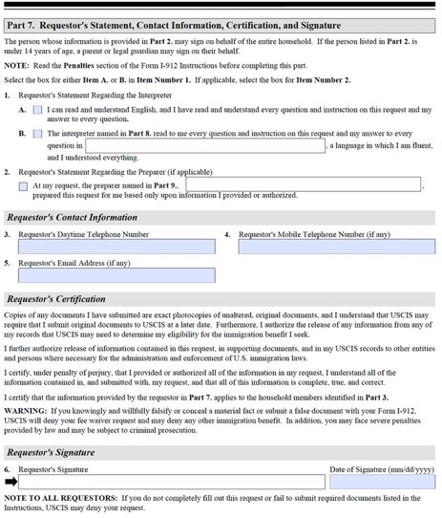
Part 7: Requestor’s Statement, Contact Information, Certification, and Signature
Must be signed by each Applicant requesting a Fee Waiver (including family members listed in Part 3)
  Q 1. A.
    Select if Applicant can speak English
  Q 1. B.
    Select if Applicant cannot speak English. Include the Applicant’s preferred language
  Q 2.
    Select if the Applicant received assistance completing the form, fill in YOUR name
  Qs 3 - 5.
    Include Applicant’s phone number, cell phone and email address (if possible)
  Q6 Applicant must sign & date at bottom

Slide 53
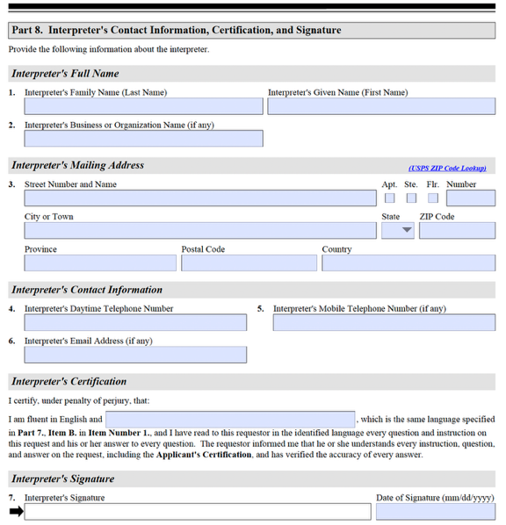
Part 8: Interpreter’s Contact Information, Certification, and Signature

Slide 54
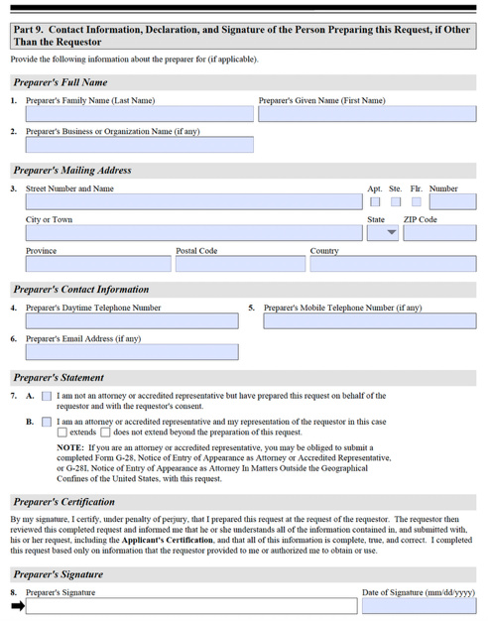
Part 9: Contact Information, Declaration and Signature of Person Preparing this Request, if Other Than the Requestor

Slide 55
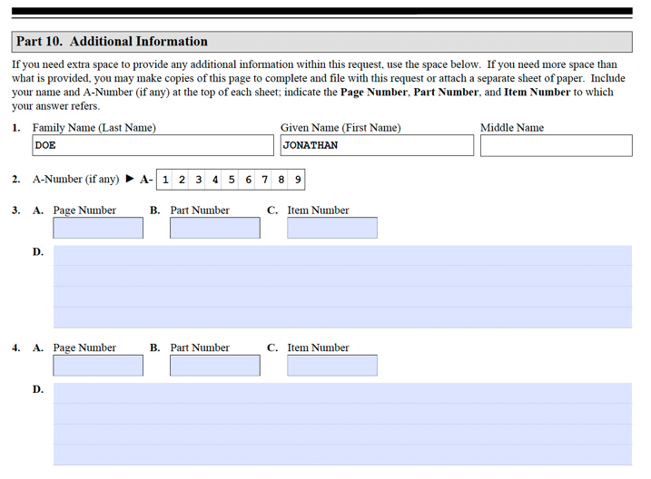
Part 10: Additional Information
Q 1.
  Include applicant’s FULL NAME
Q 2.
  Include A-Number
Q 3 - 6
  Include:
    Page Number
    Part Number
    Item Number
      Up to 4 spaces for additional information

Slide 56

Common Reasons for Rejection of Fee Waiver
Insufficient Documentary Evidence
Incomplete or Missing Documents
Not sending Current Documents
  Current = within last year for MTB
Fee Waiver Form is not properly signed and/or dated
USCIS Did Not Properly Adjudicate

Slide 57

After Filing…
If Rejected: May re-file N-400 (or other application) and new I-912 with alternative documentation or additional evidence
  If original submission was incorrectly rejected, scan and email entire N-400 and fee waiver request to lockboxsupport@uscis.dhs.gov with explanation of why fee waiver should be accepted

Slide 58
Eligibility Requirements for a REDUCED FEE
Income Between 150% and 400%
of Poverty Guidelines

Slide 59
Income Guidelines for Reduced Fee

Slide 60
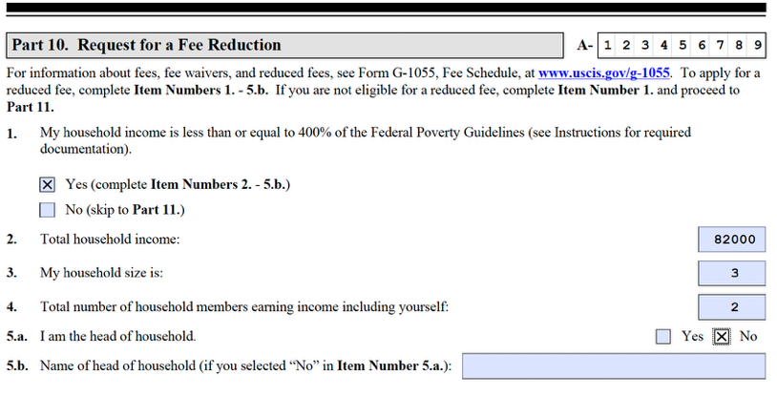
Completing N-400 Part 10: Request for Fee Reduction
Reduced N-400 fee if income between 150% to 400% of poverty guidelines

Slide 61
For additional assistance
CUNY Citizenship Now!
Shawn Rahman, Esq.
Managing Attorney, Training & Capacity Building
shawn.rahman@cuny.edu
American Immigration
Lawyers Association
Paul Rampersaud
Grassroots Advocacy Associate
prampersaud@aila.org
Notes:
Erin Lynum

