Slide 1
Hot Topics in Naturalization
Rebecca Kitson – Albuquerque, New Mexico
Ana Maria Schwartz – Houston, Texas

Slide 2

Today’s Hot Topics: Policy Shifts
Updated Natz Statistics FY2024
https://www.uscis.gov/citizenship-resource-center/naturalization-statistics
DOJ Denaturalization Policy (6/11/25)
https://www.justice.gov/civil/media/1404046/dl?inline
Revised Guidance on Form N-648 Medical Certification for Disability Exceptions (6/13/25)
https://www.uscis.gov/sites/default/files/document/policy-manual-updates/20250613-N-648MedicalCertification.pdf
Good Moral Character Evaluation Standard Policy (8/15/25) and GMC, Unlawful Voting, and False Claim to US Citizenship in the Natz Context (8/29/25)
https://www.uscis.gov/sites/default/files/document/policy-alerts/08.15.2025-Restoring_a_Good_Moral_Character_Evaluation_Standard_for_Aliens_Applying_for_Naturalization-Policy_Memorandum_FINAL.pdf
https://www.uscis.gov/sites/default/files/document/policy-manual-updates/20250829-VoterRegistrationGMC.pdf
Personal Investigation (8/22/25)
https://www.uscis.gov/sites/default/files/document/policy-manual/PM-602-0189_INA335.pdf
Other Non-Natz Specific Policy Shifts
https://www.uscis.gov/sites/default/files/document/policy-manual-updates/20250819-DiscretionaryFactors.pdf
https://www.uscis.gov/sites/default/files/document/policy-manual-updates/20250820-FalseClaimToUSCitizenship.pdf
Adjudication Trends

Slide 3

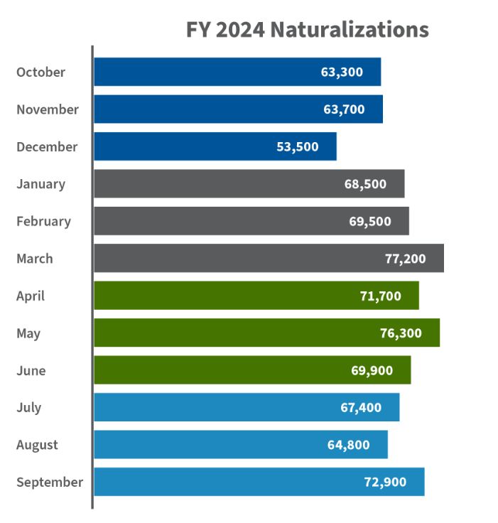

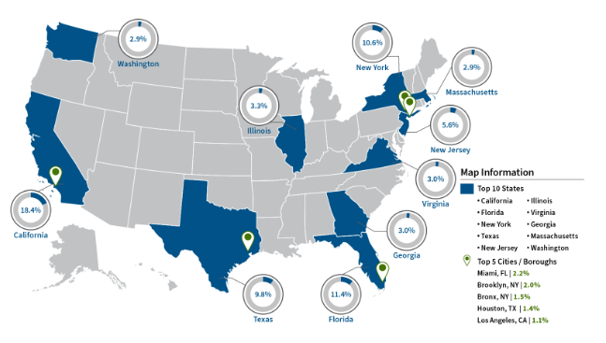
Naturalization Statistics

Slide 4
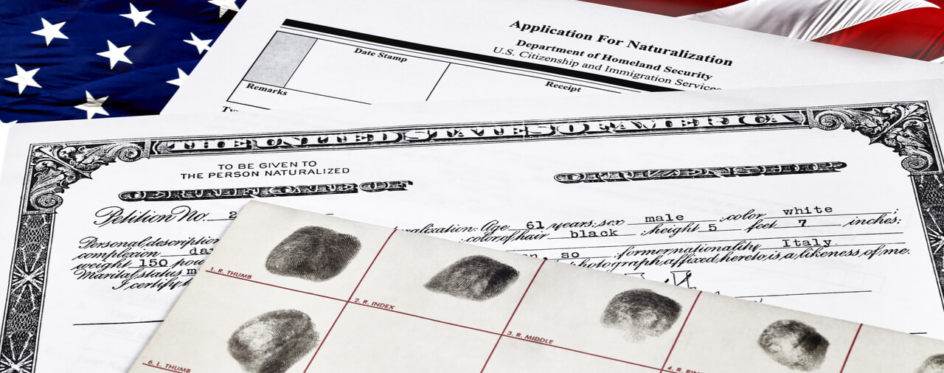
Denatz: Truth and Hyperbole
Denaturalization is RARE:
During Biden admin: 16 cases per year (64 total)
During first Trump admin: 168 filed (42 per year)
General grounds for denaturalization:
1) Procurement of naturalization by concealment of a material fact or willful misrepresentation
The government must show “deliberate deceit on the part of the person”
Related: if someone joins the Communist party, a totalitarian party, or a terrorist organization within 5 years following naturalization because it shows they were not attached to the principles of the Constitution
2) Illegal procurement of naturalization:
The applicant did not qualify for naturalization under the statute- residence requirement, physical presence, lawful admission, good moral character, and attachment to the U.S. Constitution
This can come up with criminal charges filed after naturalization but that started before naturalization.

Slide 5

Denatz: Important to Know
High burden for the government- “Clear, convincing, and unequivocal evidence which does not leave the issue in doubt”
No statute of limitations to pursue denaturalization
Key case: Maslenjak v. United States “small omissions and minor lies” do not necessitate denaturalization 582 U.S. 335, 137 S. Ct. 1918 (2017).
Denaturalization of one person can affect their family members they petitioner for

Slide 6

Revised Guidance for N-648 Submission and Review
Claims the process has been “exploited”
What does it mean?
Returns to pre-2022 policy of requiring filing of N-648 with N-400
Makes “late submissions” suspect – must justify with extenuating circumstances
Multiple N-648s raises credibility concerns
Reaffirms importance of “nexus” between disability and inability to meet English/civics requirements
Explains reasons to doubt validity of form
Policy Manual revisions:
Primarily in Vol. 12, Part E, Ch. 3

Slide 7
GMC Evaluation Standard Policy
Greater Emphasis on Positive Attributes or Contributions
USCIS will “go beyond the absence of disqualifying acts”(INA Sec. 101(f)) and require a “genuine positive assessment of who the alien is and how they have lived in their community.” They will employ a totality of the circumstances approach.
Positive factors:
Sustained community involvement and contributions in the US.
Family caregiving, responsibility and ties in the US.
Educational attainment.
Stable and lawful employment history and achievements.
Length of lawful residence in the US.
Compliance with tax obligations and financial responsibility in the US.

Slide 8
GMC Evaluation Standard Policy
Greater Scrutiny of Disqualifying Behavior and Action
Permanent bars to GMC: murder, agg felony, crime of violence, persecution, genocide, torture, or severe violations of religious freedom(PM Vol 12 Part F Ch. 4).
Conditional bars to GMC: controlled substance violations, 2 or more DWIs, false claims, voter registration and voting.
Acts that are “contrary to the average behavior of citizens in the jurisdiction”, such as “reckless or habitual traffic infractions, or harassment or aggressive solicitation.”
USCIS will review all info and question applicants to make their determination.

Slide 9

GMC Evaluation Standard Policy
Rehabilitation and Reformation – greater focus
Paying overdue child support
Compliance with probation and court obligations
Community testimony attesting to GMC
Reformation or mentoring those with a similar past
Full repayment of benefits overpayments
Full payment of overdue taxes

Slide 10
GMC Evaluation Standard Policy
Aspect | Old Approach | New Approach
Evaluation Style | Strict checklist of disqualifiers | Holistic, totality-of-circumstances assessment
Positive Factors | Mostly ignored | Actively considered and weighed
Negative Factors | Limited to statutory bars | Expanded to include discretionary negative conduct
Rehabilitation | Not typically applicable | Encouraged as supporting evidence
Officer Role | Prescriptive, rule-bound | Discretionary, subjective

Slide 11
GMC, Unlawful Voting, and False Claim U.S. Citizenship in the Naturalization Context
Shifts burden to applicant to prove that the registration form did not contain a question about whether the applicant is a U.S. citizen or that the applicant did not indicate that they were a U.S. citizen.
Provides that anyone who claims to be a U.S. citizen for any reason, including registering to vote, or having voted, will be issued an NTA. (very limited exception if each natural parent of the alien (or, in the case of an adopted alien, each adoptive parent of the alien) is or was a citizen (whether by birth or naturalization), the alien permanently resided in the United States prior to attaining the age of 16, and the alien reasonably believed at the time of such violation that he or she was a citizen, the alien shall not be considered to be deportable under any provision of this subsection based on such violation).
After an NTA issuance, USCIS generally denies the natz application under INA Sec. 318 (other than natz based on military service)

Slide 12

GMC, Unlawful Voting, and False Claim U.S. Citizenship in the Naturalization Context
BUT! “When there is evidence of one of the above-mentioned unlawful acts, as with all unlawful acts, the officer must make an assessment regarding whether the act reflects adversely on moral character and must consider any extenuating circumstances”
So it’s unclear how they will handle it, but be careful
The Policy Manual https://www.uscis.gov/policy-manual/volume-12-part-f-chapter-5

Slide 13
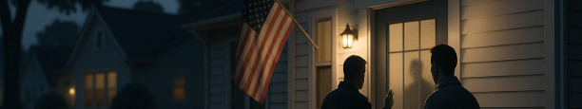
Personal Investigation: Are they doing this?
Personal or Neighborhood Investigations to corroborate eligibility for natz, in particular “attachment to the Constitution and disposition to the good order and happiness of the United States.” INA 316, INA 335, and 8 CFR 335
“At least” 5-year period prior to application
Covers place of residence and employment
Can be waived at the discretion of USCIS
Proof can be proactively submitted by the immigrant with the application from neighbors, employers, co-workers, and business associates
Not providing the evidence can impact the eligibility for naturalization

Slide 14

Other Policy Shifts: Potential Impact for Natz Cases
USCIS Anti-LGBTQIA+ Policy to “Recognize Two Sexes”
No more X gender marker, no recognizing trans folks
https://www.uscis.gov/newsroom/news-releases/uscis-updates-policy-to-recognize-two-biological-sexes#:~:text=WASHINGTON—%20U.S.%20Citizenship%20and%20Immigration,biological%20sexes%2C%20male%20and%20female.
Voter Registration at Administrative Naturalization Ceremonies
NGOs no longer allowed at Natz ceremonies, only state and local election officials are allowed to register voters.
https://www.uscis.gov/sites/default/files/document/policy-manual-updates/20250829-NatzCeremonyVoterRegistration.pdf
Screening for Anti-Americanism (8/19/25 memo):
“where an alien has endorsed, promoted, supported, or otherwise espoused the views of a terrorist organization or group, including aliens who support or promote anti-American ideologies or activities, antisemitic terrorism and antisemitic terrorist organizations, or who promote antisemitic ideologies.”
https://www.uscis.gov/newsroom/news-releases/uscis-to-consider-anti-americanism-in-immigrant-benefit-requests

Slide 15

Other Policy Shifts: Potential Impact for Natz Cases
ACH / CC Fee Payments ONLY for benefits applications
*No more checks or money orders will be accepted*
Starts 10/28/25
G-1450 for Credit cards
G-1650 for ACH
Warning: You need to contact your bank to allow DHS to withdraw the funds
https://www.federalregister.gov/documents/2025/03/28/2025-05522/modernizing-payments-to-and-from-americas-bank-account
https://www.uscis.gov/newsroom/news-releases/uscis-to-modernize-fee-payments-with-electronic-funds

Slide 16

Adjudication Trends: Processing Times
New York, NY – 9 months
Minneapolis-St Paul – 7.5 months
Miami FL – 8.5 months
Houston, TX – 8.5 months
Albuquerque, NM – 9 months
Los Angeles, CA – 8 months
Portland, OR – 7.5 months

Slide 17
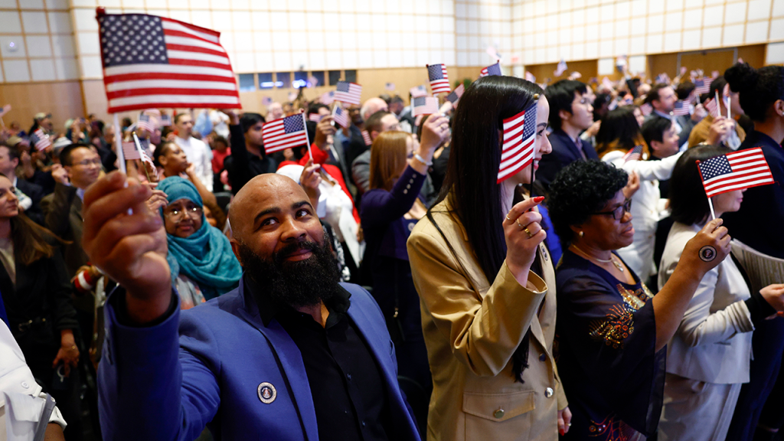
Adjudication Trends: What are we seeing?
IS it more difficult? How are policies playing out?
Some locations still have same day oaths
Approximately 90% approval rate
Approximately 10.7 million people who could apply
Trend: Social Security numbers not always being updated

Slide 18
Questions?

Slide 19
Thank You!
Rebecca Kitson – Albuquerque, New Mexico
Ana Maria Schwartz – Houston, Texas

